Slide 1

Intelligent Letter Processing System For improved efficiency in Commissioner Peshi of Guntur Municipal Corporation
KKR & KSR INSTITUTE OF TECHNOLOGY AND SCIENCES
(Accredited by NBA||Accredited with ‘A’ GradebyNAAC||Approved by A.I.C.T.E New Delhi || Affiliated to JNTUK, Kakinada) Vinjanampadu (Vil), Vatticherukuru (Md), Guntur (DT), A.P-522017.
Under the Guidance of
Ch. Durga Bhavani (Assistant professor)
Department of
Computer Science And Engineering
Presented By
V. Sasank Sai (21JR1A05J3)
Sk.Sadhik (21JR1A05H6)
T.Rohit (22JR5A0516)
Y.Yaswanth (21JR1A05J5)

Slide 2

Abstract
KKR & KSR INSTITUTE OF TECHNOLOGY AND SCIENCES
This project presents a comprehensive framework for an intelligent letter management system designed to address the challenges faced by the Commissioner Peshi of Guntur Municipal Corporation in managing the influx of letters and correspondence.
This proposed system leverages cutting edge technologies data analytics, to automate key tasks and enhance efficiency, leading to improved service delivery and great transparency within the municipality.
By automating tasks such as document categorization, tracking, and ILMS enhances operational efficiency, ensures accountability, and timely supports resolution of public grievances.
This system not only improves communication workflows but also fosters transparency and responsiveness in municipal administration, thereby strengthening governance and citizen trust.

Slide 3
Introduction
KKR & KSR INSTITUTE OF TECHNOLOGY AND SCIENCES
Currently ,Guntur Municipal Corporation (GMC) manages a large volume of official letters and correspondences on a daily basis. These letters, which include citizen grievances, internal communications, approvals, so it plays a critical role in the smooth functioning of municipal governance.
The management of these letters is largely manual or based on outdated systems, which leads to inefficiencies such as delays in processing, difficulty in tracking letter status, misplacement of critical documents, and lack of transparency in communication workflows.
To address these challenges, there is a requirement for an Efficient Letter Management System that automates the letter handling process, improves tracking and status updates, ensures secure digital storage, and enhances overall transparency and accountability in the corporation’s operations.
This inefficient system hampers timely decision-making, reduces productivity, and leads to dissatisfaction among citizens and stakeholders. For instance, delayed responses to citizen grievances can harm public trust and disrupt civic operations.

Slide 4
Literature Review
1.The paper titled "ICT-Enabled Municipal Governance: Case Studies in India" (2022), authored by Dr. Rekha Jain , This article explores the adoption of ICT (Information and Communication Technology) tools for enhancing the operational efficiency of municipal governance in India. It includes case studies from various cities demonstrating the use of digital tools for correspondence tracking and management.
2.The paper titled "Digitizing Public Services: Transforming Local Governance with AI" (2021), authored by Dr. Rajendra Pratap, This article explores how AI and machine learning techniques can be applied to municipal operations, particularly in improving the efficiency of services such as letter processing, waste management, and traffic control.It delves into the challenges and opportunities of integrating AI into government processes.
3.The paper titled "Smart Governance with AI: Transforming Municipal Operations" (2021), authored by Dr. Anupam Basu,This case study outlines the design and implementation of an AI-based letter management system used to automate the intake, categorization, and tracking of letters in a municipal setup. The system integrates OCR for scanning letters, NLP for content analysis, and machine learning for predicting and automating routing decisions.
KKR & KSR INSTITUTE OF TECHNOLOGY AND SCIENCES

Slide 5
KKR & KSR INSTITUTE OF TECHNOLOGY AND SCIENCES
4.The paper, titled "Towards Paperless Municipal Offices: A Digital Transformation Framework" (2021), authored by Dr. Venkatesh Umakumar,presents a framework for digital transformation in municipal offices, with a focus on moving towards paperless operations. It emphasizes the need for digital solutions to automate document management, streamline workflows, and enable faster processing of public correspondence.
5.The paper "AI-Based Natural Language Processing for Document Categorization", authored by Prof. Arun Agarwal(2020), The article discusses the application of Natural Language Processing (NLP) for automating document categorization in government agencies. It highlights how NLP models can be trained to identify key information from letters, classify them based on urgency or type (e.g., complaints, requests), and route them to the appropriate departments.
6.The paper titled "Optimizing Public Service Delivery through Digital Systems" (2020), authored by Dr. Rekha Jain, This paper explores the role of digital systems such as OCR and NLP in enhancing public service delivery, particularly in relation to grievance redressal. The authors focus on how automated systems can help manage public complaints, process them efficiently, and ensure timely follow-ups, reducing delays and human errors.

Slide 6
KKR & KSR INSTITUTE OF TECHNOLOGY AND SCIENCES
7. The paper titled " E-Governance in Municipal Corporations: Lessons from India " (2019), authored by Dr. Rajendra Pratap Gupta, This paper explores the use of machine learning (ML) to automate government communication processes, such as prioritizing letters based on content and urgency. The authors discuss various ML algorithms that can analyze communication content and make decisions on how to route or respond to requests.
8. The paper titled " Automating Government Communications with Machine Learning s" (2018), authored by Dr. Prof. Arun Agarwal,The article provides an overview of e-governance initiatives in Indian municipal corporations, focusing on how digitization has improved operational efficiency.It discusses the automation of administrative tasks, such as document processing, that were previously time-consuming and prone to errors.

Slide 7
Problem Identification
KKR & KSR INSTITUTE OF TECHNOLOGY AND SCIENCES
1. Scalability and performance Issues:
Basic search functionality without advanced filters or metadata tagging.
2. Limited Search and Filtering capabilities:
Outdated or cluttered interfaces hinder navigation and make the system difficult to use.
3. Lack of Integration with Other Systems:
The system slows down or crashes under high workloads or large data volumes.
4. Delayed or Irrelevant Notifications:
Notifications are not real-time, customizable, or delivered across multiple channels.
5. Inadequate Security Measure:
LMS is often isolate, with limited ability to integrate with email servers, document management tools, or workflow automation problem.

Slide 8
Proposed System
KKR & KSR INSTITUTE OF TECHNOLOGY AND SCIENCES
Centralized Repository
A secured web-based database where all letters (incoming and outgoing) are stored , accessible from anywhere.
2. Dynamic Dashboards:
A user friendly dashboard to view real time statistics, such as the total number of letters received, sent, or pending.
3. Search and Filter Options:
Advanced search functionality with filters for date department, sender, subject and letter type, etc…
4. Status tracking:
Track the status of letters, such as “Received”, Under Review”, “Responded,” or “closed”.
5. File Attachments:
Upload and manage files( e.g., Pdf’s , images) associated with each letter.
6. Role Based Access Control:
Define roles such as Admin, Manager and staff with permissions tailored to each role.
7. Notification and Reminders:
Automated email or SMS notification for new letters, status updates or pending tasks,
8. Audit log:
A complete log of user activates to ensure accountability and transparency.

Slide 9
Requirement Analysis
KKR & KSR INSTITUTE OF TECHNOLOGY AND SCIENCES
Functional Requirements:
  Centralized repository for storing and managing letters.
  Advanced search and filtering options.
  Real-time status tracking and notifications.
  Role-based access control for secure operations.
  Audit logs for accountability.
Non-Functional Requirements:
  High scalability to handle large volumes of letters.
  Secure data transmission and storage (SSL encryption).
  User-friendly interface for easy adoption.
  Compatibility with multiple devices and platforms.

Slide 10
Module Description
KKR & KSR INSTITUTE OF TECHNOLOGY AND SCIENCES
• User Registration and Authentication:
Users, including administrators, employees, and external stakeholders, register on the system with unique identities. Authentication is handled through secure login credentials, multi-factor authentication (MFA), or blockchain-based digital signatures to prevent unauthorized access and ensure data privacy.
• Letter Scanning and Digitization:
The system utilizes OCR (Optical Character Recognition) to scan physical letters, converting them into machine-readable text. This allows for efficient document handling, indexing, and searching. AI-based image processing is also employed to enhance clarity and remove noise from scanned documents.

Slide 11
KKR & KSR INSTITUTE OF TECHNOLOGY AND SCIENCES
• Content Classification and Categorization:
Natural Language Processing (NLP) algorithms analyse and categorize letters based on their content, sender, and priority. Documents are automatically classified into predefined categories, such as official correspondence, legal notices, financial documents, and general inquiries, streamlining workflow and reducing manual sorting efforts.
• Automated Routing and Workflow Management:
The system assigns letters to the appropriate departments or personnel based on predefined rules or machine learning recommendations. Smart workflows ensure that high-priority letters are processed first, reducing response time and improving efficiency.
• Blockchain-Based Data Storage:
Letter records, processing logs, and access histories are securely stored on a blockchain ledger, ensuring tamper-proof documentation, auditability, and data integrity. This feature is particularly useful for government, legal, and financial organizations that require verifiable communication records.

Slide 12
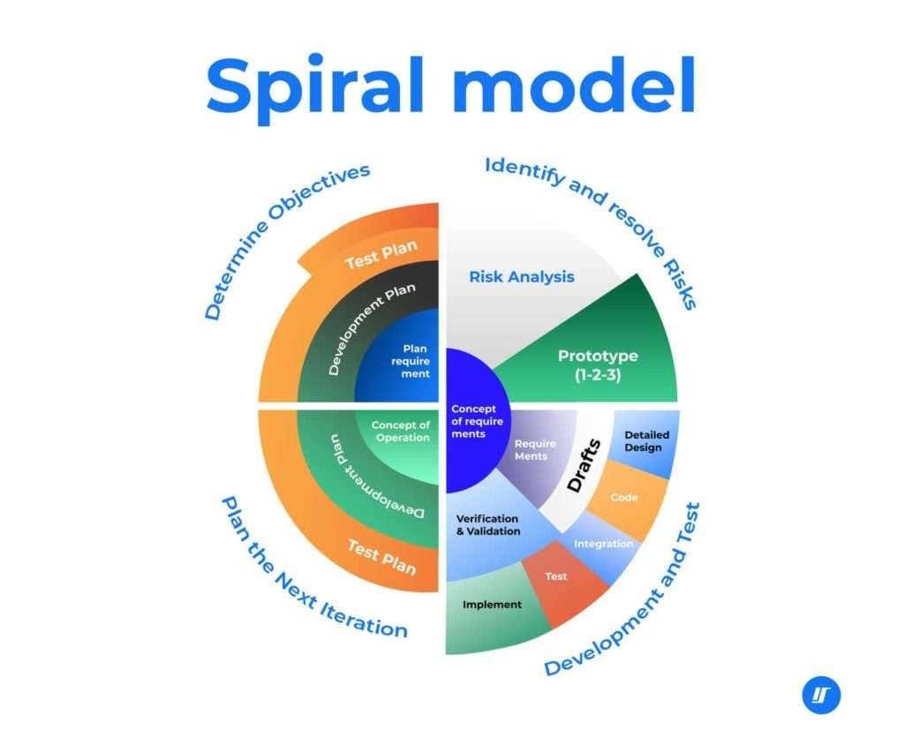
Process Model Used
KKR & KSR INSTITUTE OF TECHNOLOGY AND SCIENCES
Spiral Methodology:
  Iterative development with regular feedback and improvements.
  Focus on delivering functional modules in sprints.
Key Phases:
  Requirement gathering and analysis.
  System design and prototyping.
  Development and testing.
  Deployment and maintenance.

Slide 13
KKR & KSR INSTITUTE OF TECHNOLOGY AND SCIENCES
1. Planning Phase:
• Gather requirements from stakeholders (admin, staff, approvers) regarding document upload, classification, forwarding, status tracking, and archiving.
• Identify risks such as unauthorized access, data loss, inconsistent workflows, or integration issues with existing systems (email, ERP).
• Decide on tech stack: PHP, MySQL, JavaScript, Bootstrap, etc.
2. Risk Analysis Phase:
• Evaluate risks like SQL injection vulnerabilities, inefficient file storage, or delays in approval chains.
• Use authentication and role-based access control.
• Sanitize inputs and implement secure upload/download mechanisms.
• Design a scalable and modular database schema.

Slide 14
KKR & KSR INSTITUTE OF TECHNOLOGY AND SCIENCES
3. Engineering Phase:
• User authentication and access control.
• Document upload, metadata tagging, and category-based organization.
• Workflow module for forwarding letters to concerned departments.
• Dashboard for status updates and alerts.
• Backend using PHP with MySQL, frontend with HTML/CSS/JS/Bootstrap.
4. Evaluation Phase:
• Usability, responsiveness, and accuracy in document routing.
• Security of uploaded documents and user roles.
• Performance under load (bulk uploads, multiple users).
• Collect feedback from users—admin, departments, and clerical staff.
accordingly.

Slide 15
Design Phase
KKR & KSR INSTITUTE OF TECHNOLOGY AND SCIENCES
Design Concepts:
• Personalized User Experience:
The platform uses machine learning algorithms to provide tailored product recommendations based on user behaviour, preferences, and past interactions, ensuring a highly personalized shopping experience.
• Dynamic Product Categorization:
Products are categorized using attribute-based tagging enabling efficient search and discovery of products that match user preferences.
• Multi-Algorithmic Recommendation Engine:
The platform combines collaborative filtering and content-based filtering to deliver accurate and relevant product suggestions, enhancing user engagement and satisfaction.

Slide 16
KKR & KSR INSTITUTE OF TECHNOLOGY AND SCIENCES
Design Constraints
• Data Privacy and Security:
The system must ensure confidentiality and integrity of documents through secure authentication, role-based access control, and encryption of sensitive data, complying with institutional and data protection policies.
• Scalability:
The system should support growing volumes of documents, users, and workflows without significant performance degradation, requiring efficient database design and modular code architecture.
• Real-Time Notifications and Updates:
The platform must provide real-time status updates and notifications to users for document movement, approvals, and deadlines, demanding low-latency processing and reliable backend services.
• Integration with Legacy Systems:
The system must integrate smoothly with existing institutional tools (e.g., email servers, LDAP/SSO login, ERP systems), which may vary in technology and protocols.

Slide 17
KKR & KSR INSTITUTE OF TECHNOLOGY AND SCIENCES
Logical Design
• Document Submission → Users upload documents through the web or mobile interface.
• Metadata and Document Storage → The system stores documents and associated metadata in a secure database (e.g., MySQL or PostgreSQL).
• Approval Workflow → When a document is submitted, it enters the approval queue. Assigned users receive notifications and either approve, reject, or comment on the document.
• Automated Notifications → The system sends automatic notifications to users involved in the approval process and tracks all actions for accountability.
• Admin Actions → Admins can view, modify, and manage document statuses, user roles, and system-wide settings.
• Audit and Logs → The system tracks all document actions and user interactions for auditing purposes.

Slide 18
Design Phase
KKR & KSR INSTITUTE OF TECHNOLOGY AND SCIENCES
Personalized User Experience:
The system provides a personalized dashboard for different user roles (e.g., Admin, Staff, Approver), ensuring relevant access and actions such as uploading, forwarding, reviewing, and archiving documents.
Metadata-Driven Document Tagging:
Each letter/document is tagged with essential metadata (e.g., subject, department, priority, sender, date), allowing efficient categorization, filtering, and retrieval of documents.
Secure Upload, Access, and Versioning:
Documents are routed automatically through predefined workflows based on department and urgency, while the system updates statuses (e.g., "Pending Review", "Approved", "Archived") in real-time to improve transparency and traceability.
Multi-Algorithmic Recommendation Engine:
Documents are securely uploaded and managed using encrypted storage paths. Version control ensures document history is maintained and changes are tracked, with rollback options if needed.

Slide 19
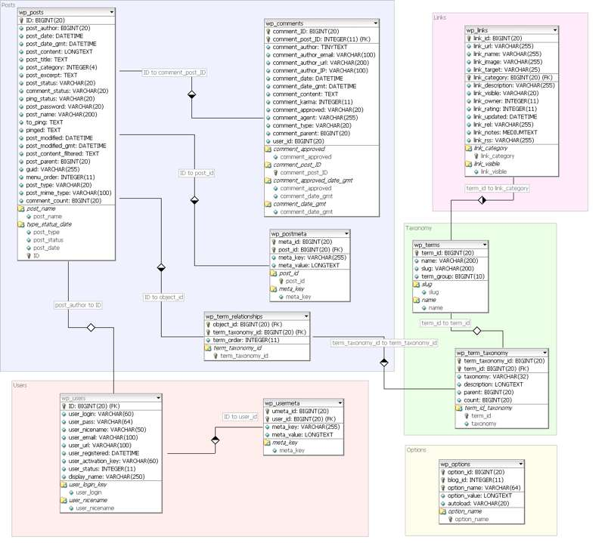
Class Diagram
KKR & KSR INSTITUTE OF TECHNOLOGY AND SCIENCES
A class diagram for the Letter Management System features User, Document, Folder, AccessControl, and VersionControl classes. The User class manages user information and operations such as login and document sharing. The Document class handles metadata, content storage, and version history. The Folder class organizes documents hierarchically. Access Control manages permissions like view/edit rights for each user, while Version Control ensures updates to documents are properly tracked. This structure facilitates secure, organized, and collaborative document handling in the system.

Slide 20
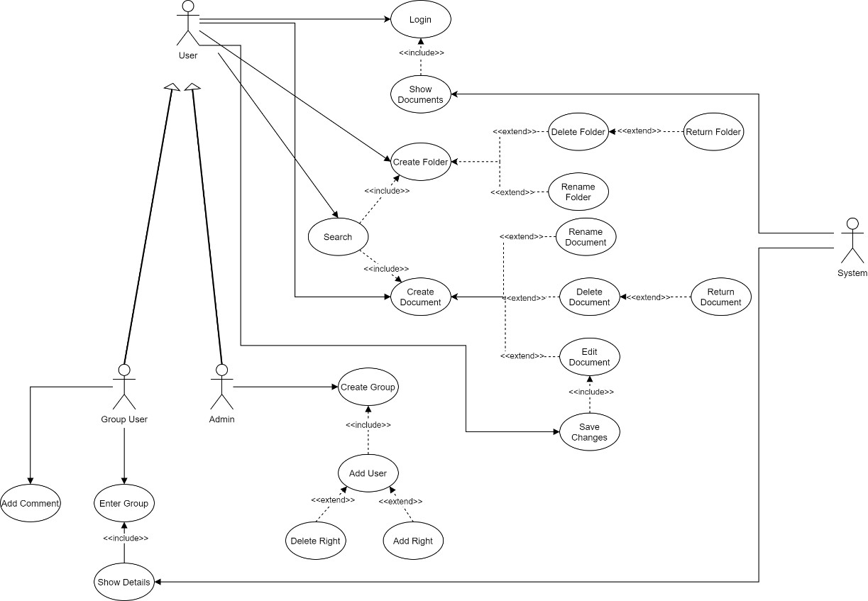
Use Case Diagram
KKR & KSR INSTITUTE OF TECHNOLOGY AND SCIENCES
The key functionalities of the Letter Management System, categorized by the roles of User, Group User, and Admin.For Users, the system offers essential document operations such as logging in, searching, viewing documents, creating folders and documents, as well as editing, deleting, renaming, and returning documents or folders. Users can also save changes and organize files efficiently within folders.Group Users can collaborate by entering shared groups, viewing group-specific document details, and adding comments to documents. This enhances communication and team-based document handling within shared workspaces.Admins have extended control, including creating user groups, adding users to groups, and managing permissions through adding or deleting access rights. .

Slide 21
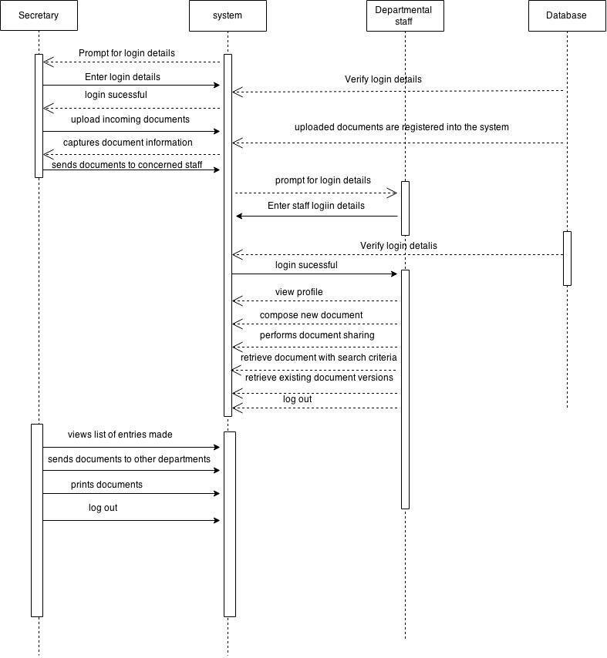
Sequence Diagram
KKR & KSR INSTITUTE OF TECHNOLOGY AND SCIENCES
The sequence of actions in the Letter Management System when a department official manages incoming letters. The process begins when the Department Official inputs login credentials. The System verifies these details and grants access. Upon successful login, the official can upload incoming documents, which are then registered and stored by the system.Once documents are uploaded, the official can view profiles, review documents, perform document-related actions, and forward them to the concerned section.

Slide 22
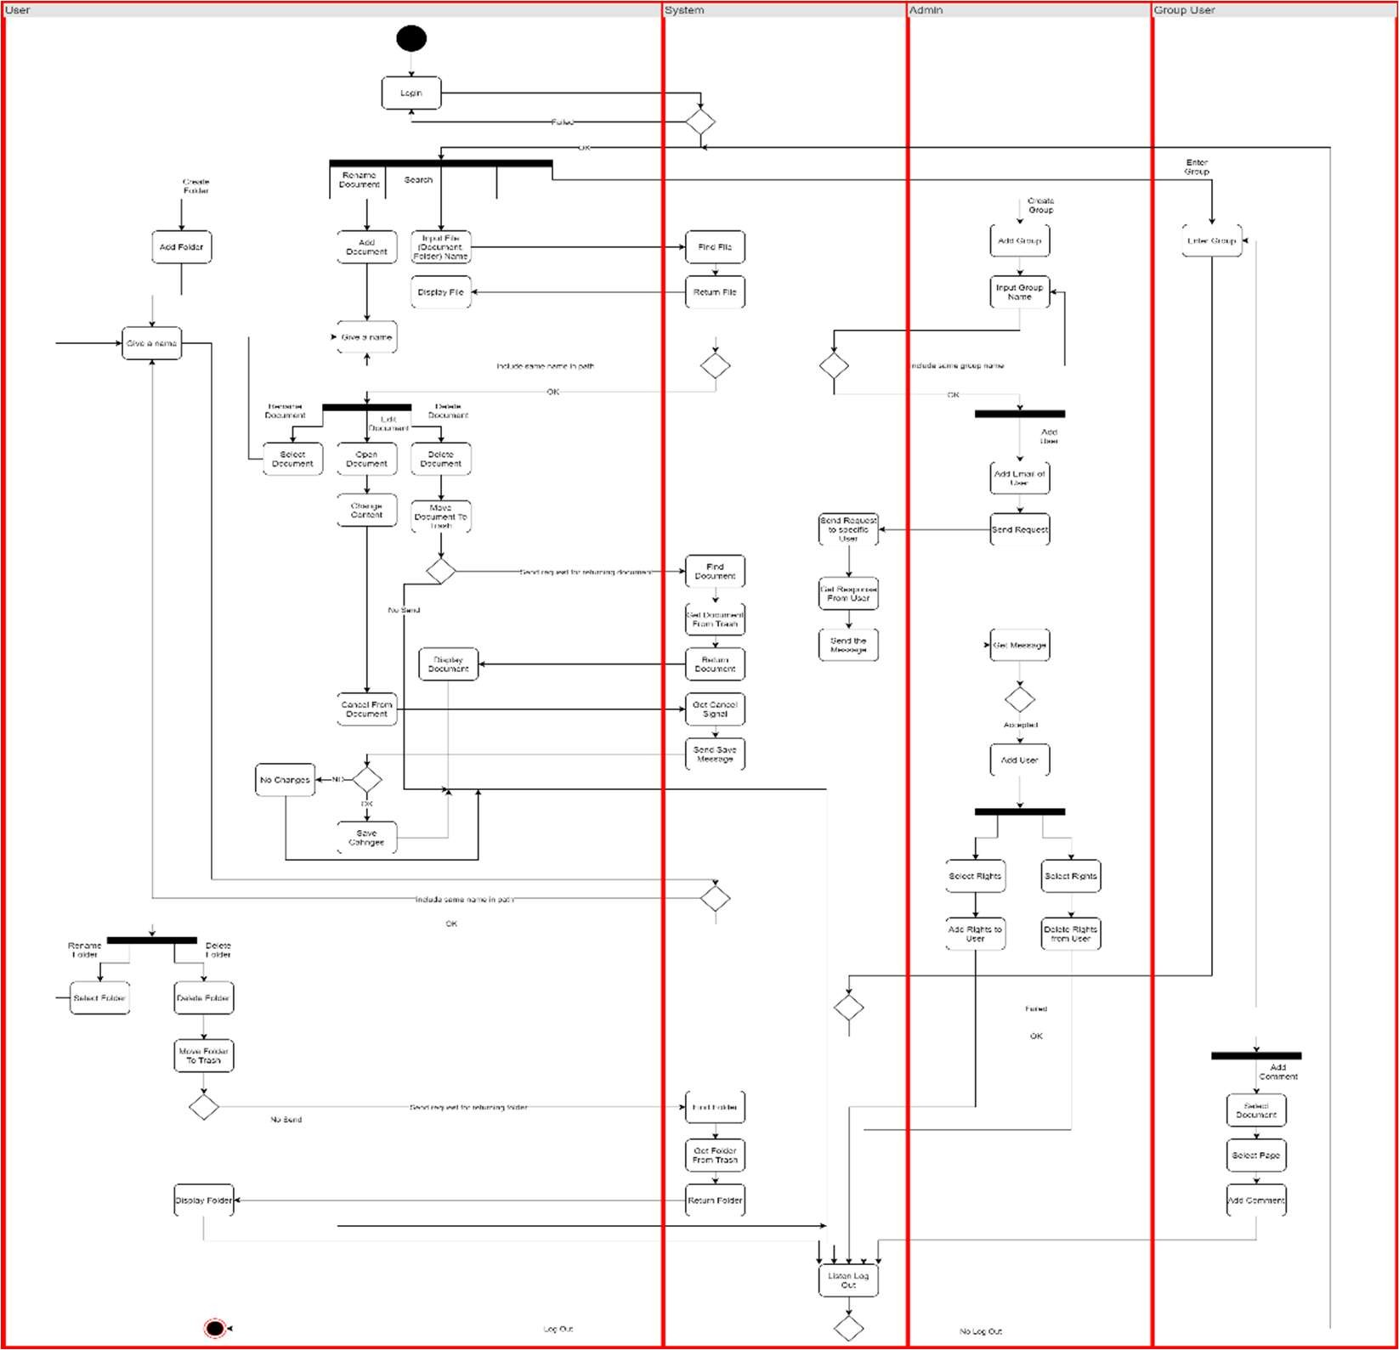
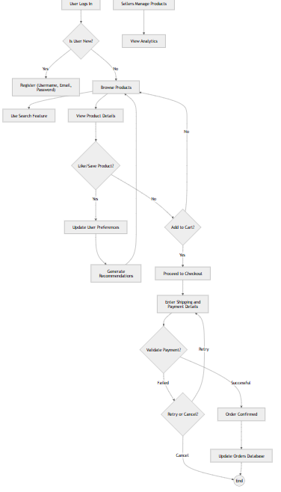
Activity Diagram
KKR & KSR INSTITUTE OF TECHNOLOGY AND SCIENCES
The Letter Management System follows a structured process to manage documents from submission to approval. When a user submits a letter or document into the system, the system captures necessary metadata such as the title, submission date, and user details. The document is then added to a queue for review by an approver. Once the document is in the queue, the approver begins the review process. They evaluate the document based on predefined criteria such as completeness, accuracy, and other relevant standards. If the document meets the approval requirements, the approver has the option to either approve or reject the document.

Slide 23
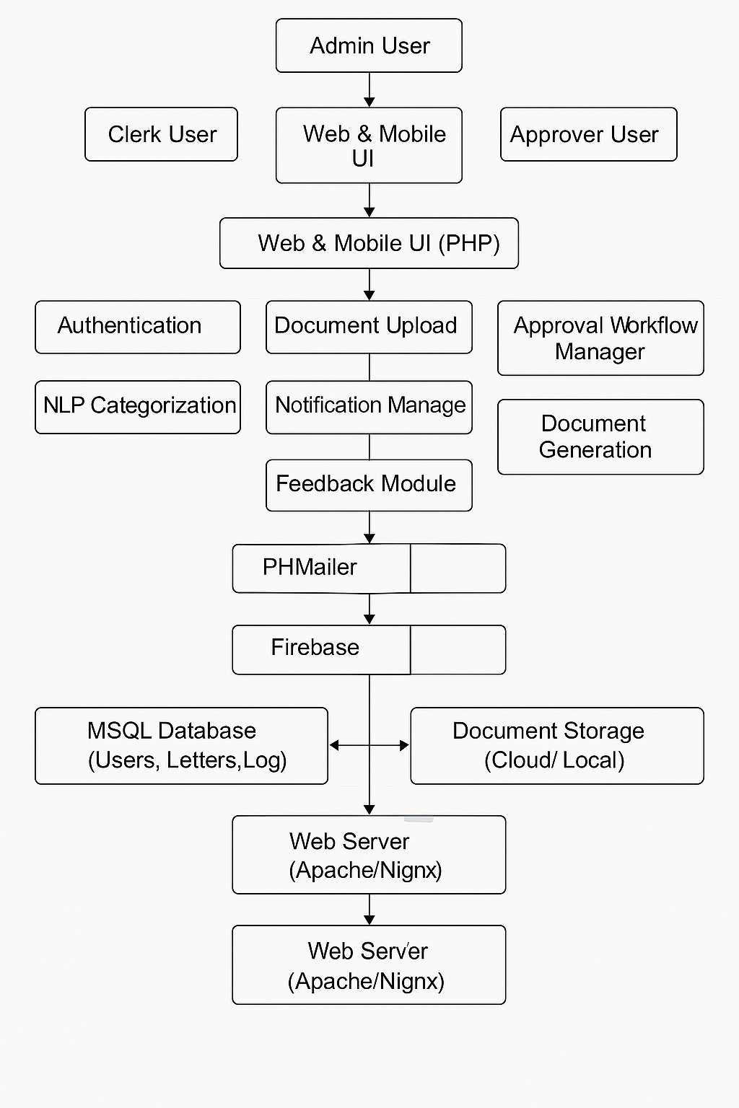
Architectural Design
KKR & KSR INSTITUTE OF TECHNOLOGY AND SCIENCES

Slide 24
Algorithm Design
KKR & KSR INSTITUTE OF TECHNOLOGY AND SCIENCES
Step 1: Input and Initialization
• Step 1.1: Start the system.
• Step 1.2: Initialize letter management system components (user interfaces, databases, communication systems).
• Step 1.3: Establish connection between user inputs and the letter management database.
• Step 1.4: Configure system for letter processing (sorting, assigning to departments).
• Step 1.5: Set up user notifications for letter status updates (e.g., dispatched, received, viewed).

Slide 25
KKR & KSR INSTITUTE OF TECHNOLOGY AND SCIENCES
Step 2: Letter Submission (User Interaction)
Step 2.1: User creates a letter in the system, providing necessary details (sender, recipient, subject, content).
Step 2.2: Validate input fields (e.g., check for missing data, verify recipient information).
Step 2.3: Submit the letter to the system for processing and store it in the letter database.
Step 3: Letter Sorting and Assignment
Step 3.1: After letter submission, sort the letter based on its category (e.g., urgent, standard).
Step 3.2: Assign letter to appropriate department or user based on letter type.
Step 3.3: Generate a unique identifier (ID) for tracking the letter.
Step 3.4: Store the letter in the appropriate section of the database, updating its status to "In-Process."

Slide 26
KKR & KSR INSTITUTE OF TECHNOLOGY AND SCIENCES
Step 4: Status Update (Letter Progression)
Step 4.1: After sorting and assignment, the system updates the letter's status (e.g., "Assigned," "In Review," "Awaiting Approval").
Step 4.2: The system triggers automatic notifications to relevant users (e.g., recipient, admin).
Step 4.3: Monitor the letter's status progression until it reaches completion (e.g., "Delivered," "Read").
Step 5: Letter Delivery and Notification
Step 5.1: Once the letter is delivered to the recipient, the system updates the letter’s status to "Delivered."
Step 5.2: A notification is sent to the sender and recipient confirming the letter’s successful delivery.
Step 5.3: If the letter requires action from the recipient (e.g., acknowledgment, signature), the system triggers an action reminder.

Slide 27
KKR & KSR INSTITUTE OF TECHNOLOGY AND SCIENCES
Step 6: Letter Tracking and History
Step 6.1: After delivery, the letter’s history (e.g., timestamps, department handling, delivery details) is stored in the database.
Step 6.2: Users can view the letter’s full history and its current status in the system at any time.
Step 6.3: The system provides real-time tracking updates to both senders and recipients regarding any progress made on the letter.
Step 7: Finalization and Closure
Step 7.1: Once the recipient has completed required actions (e.g., acknowledgment), update the letter status to "Closed."
Step 7.2: Notify the sender and recipient that the process is complete, and the letter has been closed.
Step 7.3: The letter is archived for future reference or record-keeping.

Slide 28
KKR & KSR INSTITUTE OF TECHNOLOGY AND SCIENCES
Step 8: Stop
Step 8.1: Stop when all processes are complete:
Document uploads are validated and securely stored.
Document classification and metadata tagging are finalized.
Search and retrieval processes are completed.
Approval workflows are executed and updated.
Audit trails and activity logs are securely stored.

Slide 29
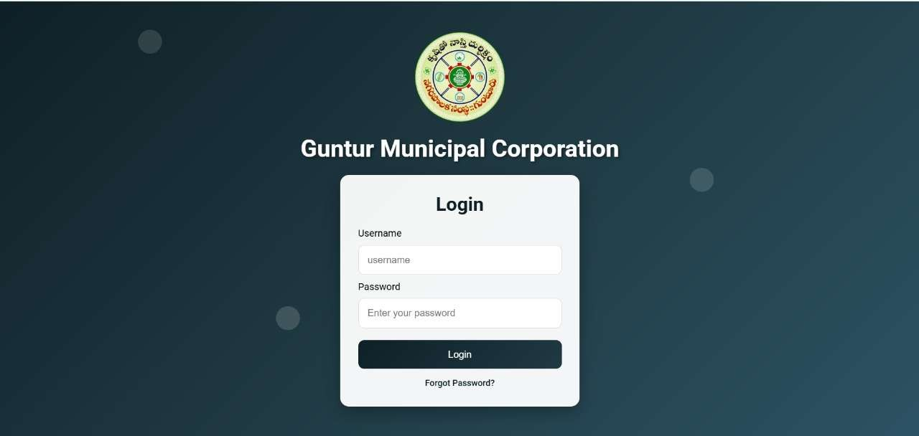
KKR & KSR INSTITUTE OF TECHNOLOGY AND SCIENCES
Output Screens
Login page

Slide 30
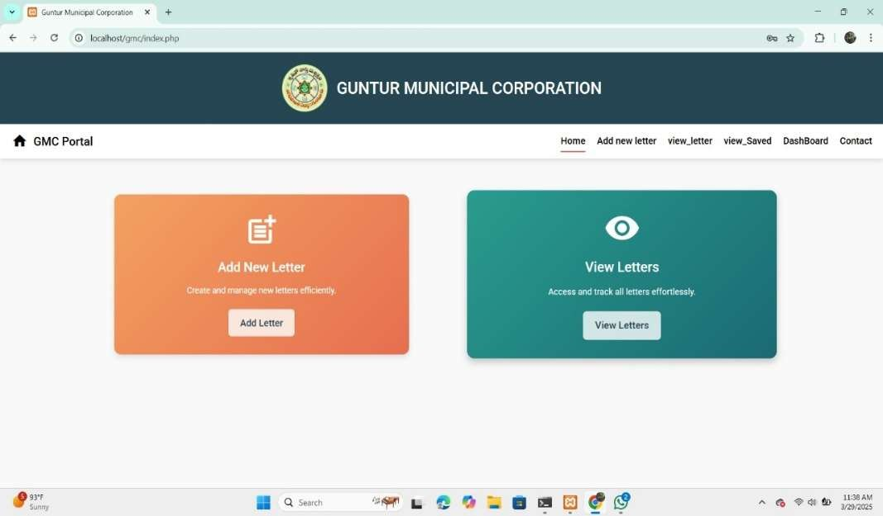
KKR & KSR INSTITUTE OF TECHNOLOGY AND SCIENCES
Home Screen

Slide 31
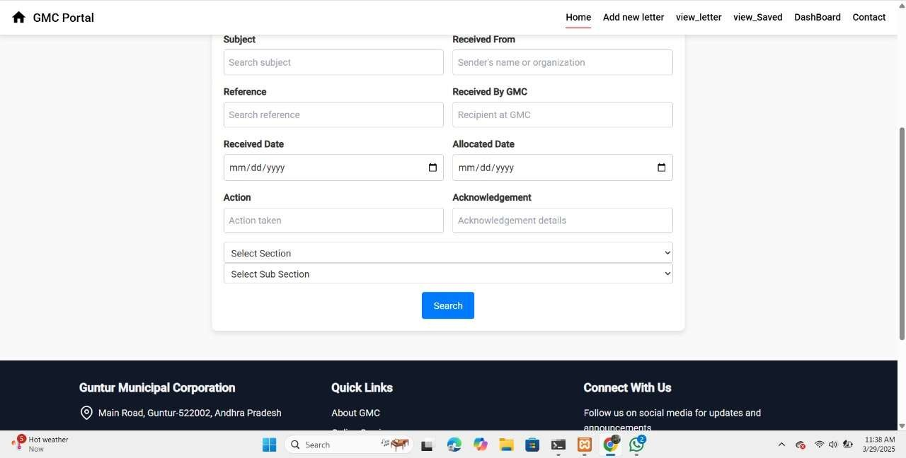
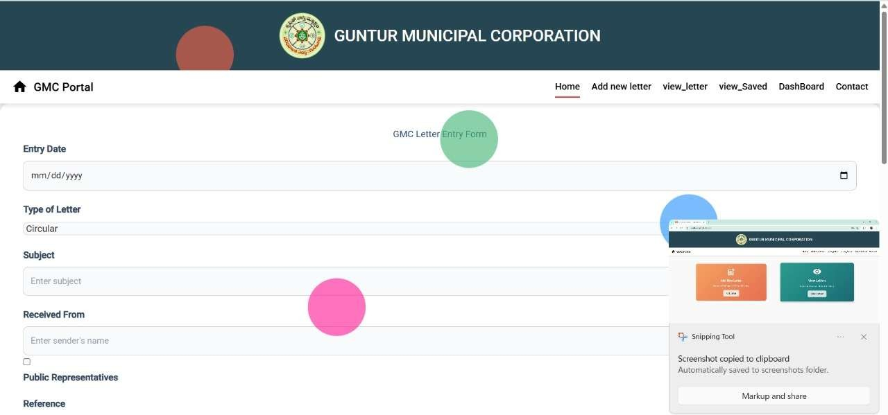
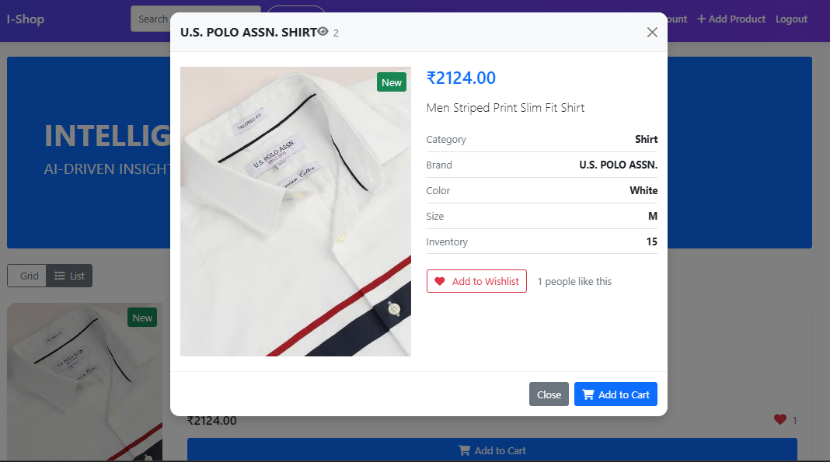
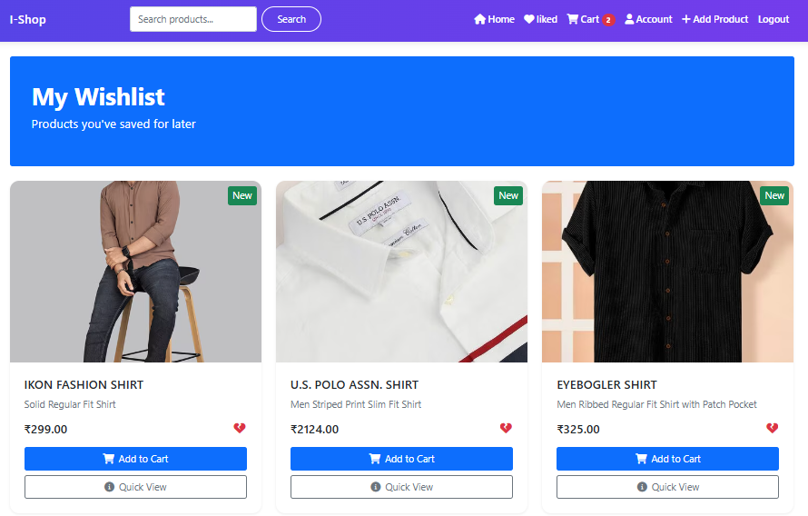
KKR & KSR INSTITUTE OF TECHNOLOGY AND SCIENCES
Search & Filter Page
Entry Form Page

Slide 32
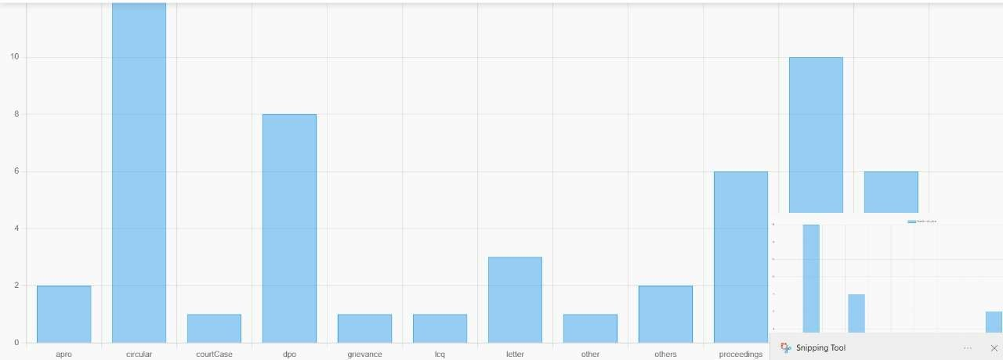
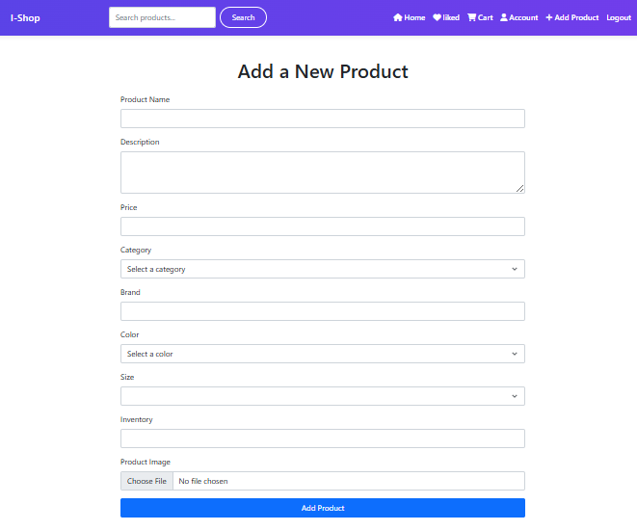
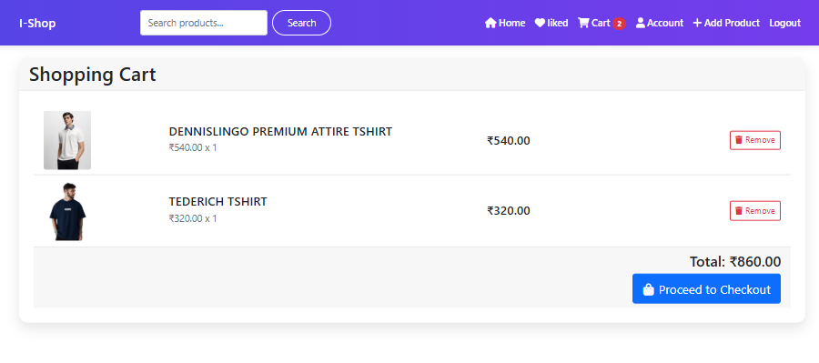
KKR & KSR INSTITUTE OF TECHNOLOGY AND SCIENCES
Dashboard Page

Slide 33
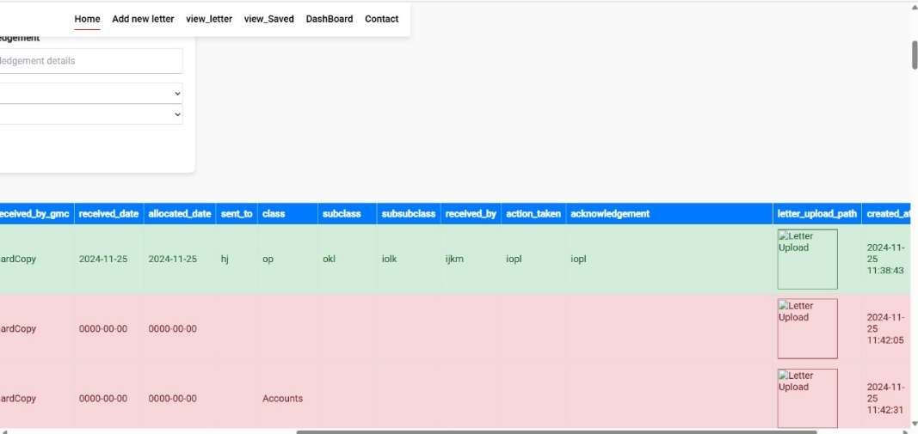
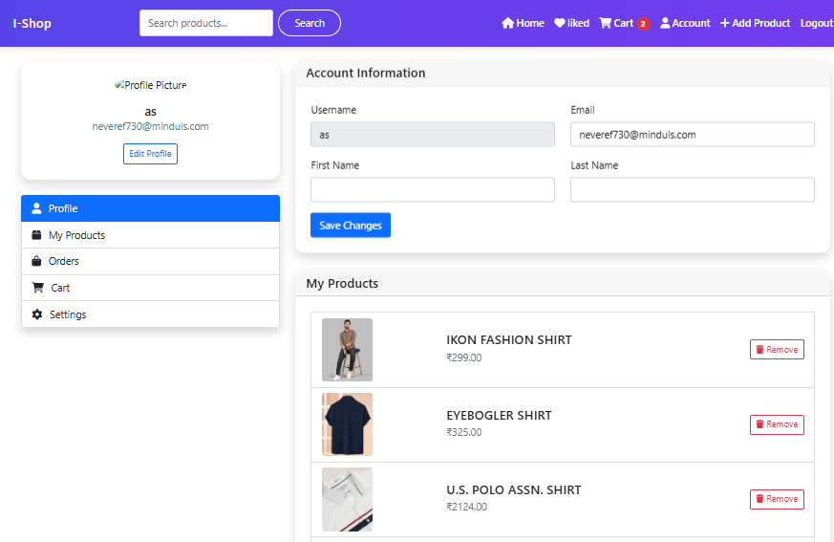
KKR & KSR INSTITUTE OF TECHNOLOGY AND SCIENCES
Results Page

Slide 34
Conclusion
KKR & KSR INSTITUTE OF TECHNOLOGY AND SCIENCES
The PHP Full-Stack Letter Management System has successfully streamlined document management processes by providing a centralized platform for document submission, categorization, approval, and retrieval. The system integrates a user-friendly interface with robust backend functionalities, ensuring a seamless experience for all stakeholders involved in document management. The workflow automation allows for efficient approval processes, ensuring timely handling of documents while minimizing human errors.
The reporting and analytics features offer valuable insights into document processing metrics, enabling organizations to optimize their operations further. With advanced search functionalities, version control, and audit trails, the system offers a high level of security and traceability, essential for organizations that handle sensitive information. Overall, the system improves productivity, reduces the time spent on administrative tasks, and enhances collaboration between users, leading to more effective and organized document management

Slide 35
KKR & KSR INSTITUTE OF TECHNOLOGY AND SCIENCES
Thank You

